Slide 1
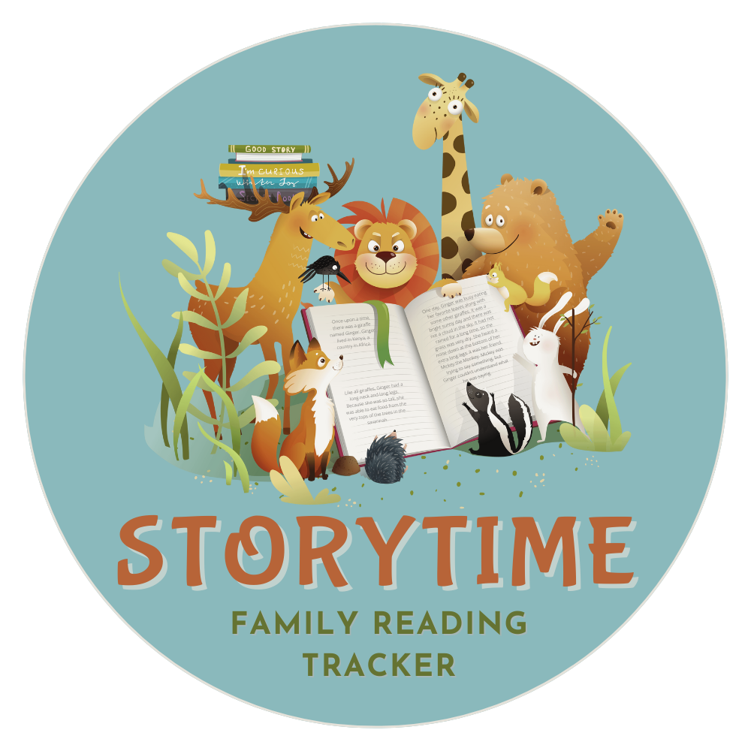
WELCOME TO
Specially created to
Allow families to:
Setup accounts for each member
Add Books to virtual bookshelf
Log Reading Hours
See reading history
Create healthy habits with ease!

Slide 2

Aubrey
“I really like reading about fairies and when
Mommy reads to me. I also like pizza and Barbies and fancy clothes!”
Add image that represents this persona
Goals
I want to earn lots of rewards!
Mom wants me to read every day to build good habits.
I want this app to be easy for me to use.
Frustrations
I am very busy with dance class and school.
My brothers and sisters read way harder books than I can read.
I’m not very fast at reading.
Age:
Education:
Hometown:
Family:
Occupation:
8
3rd grade
Chicago, IL
Youngest of 3
Student
I usually read daily after bath from 7-7:30. On days I have homework, I am usually more tired and want mom to read to me. I read a lot of fairy tales but they are usually not very long so I have more than one book to read every night.

Slide 3
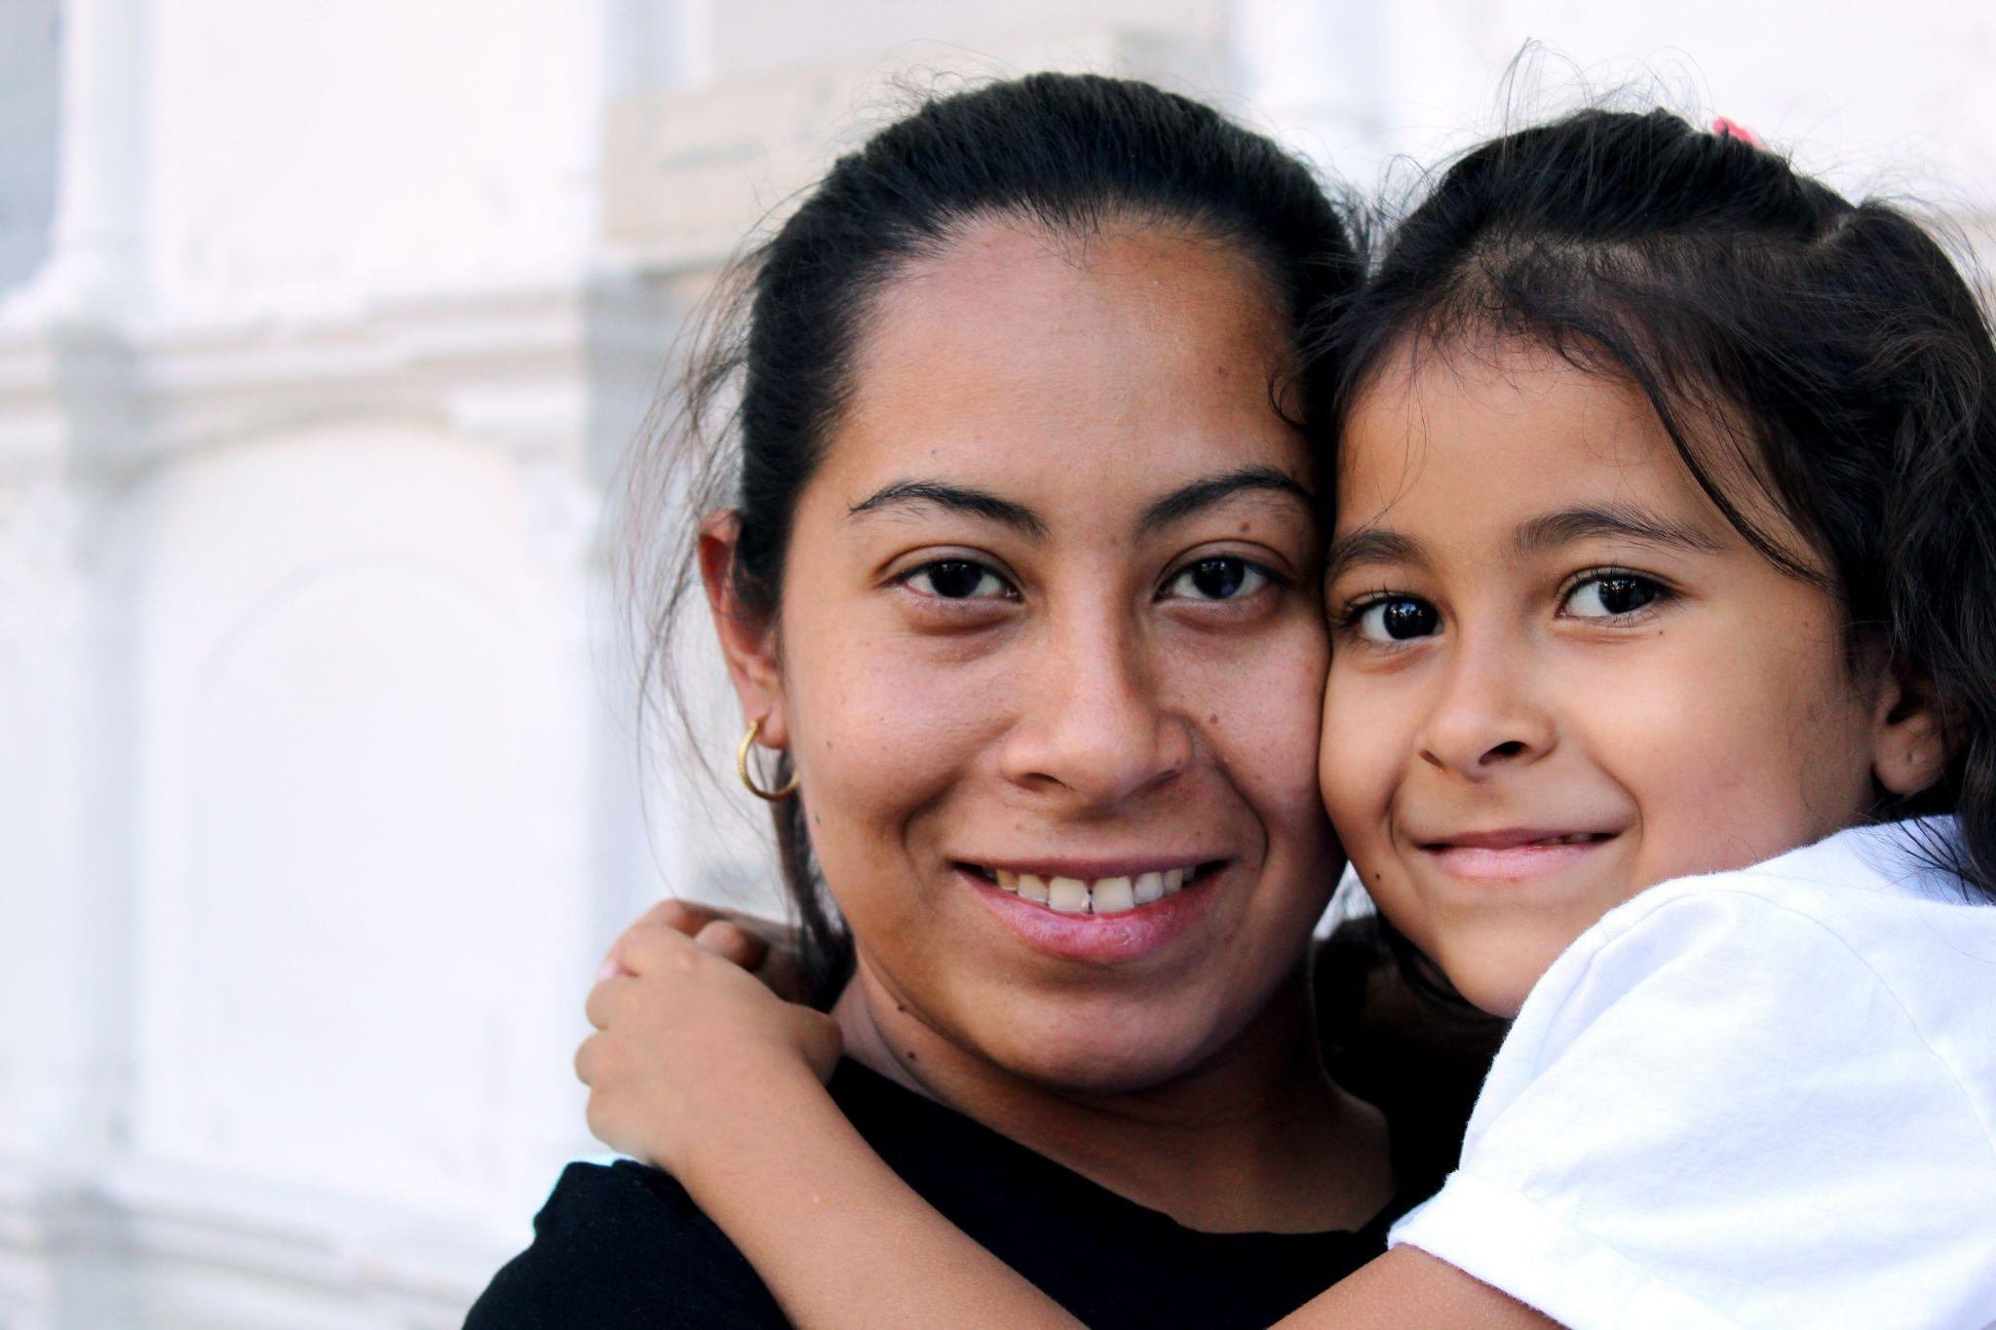
“I want my kids to develop a love for reading and be intrinsically motivated. I enjoy building routines, but am busy and want simplicity!”
Amanda
Add image that represents this persona
Goals
I want happy and well-read kids
I want them to be able to handle logging on their own to save me time.
I want the prizes to realistic and attainable, and I want to be able to choose them myself.
Frustrations
I need my apps to be simple because I get confused with technology.
I want my kids to get along and not be too competitive.
My youngest is now 8 and needs my help with entering books.
My oldest kids are diverse readers and need to be able to enter their own books.
Age:
Education:
Hometown:
Family:
Occupation:
42
BA in Business Admin
Chicago, IL
3 kids, husband, dogs
Account manager
I usually read daily after bath from 7-7:30. On days I have homework, I am usually more tired and want mom to read to me. I read a lot of fairy tales but they are usually not very long so I have more than one book to read every night.

Slide 4
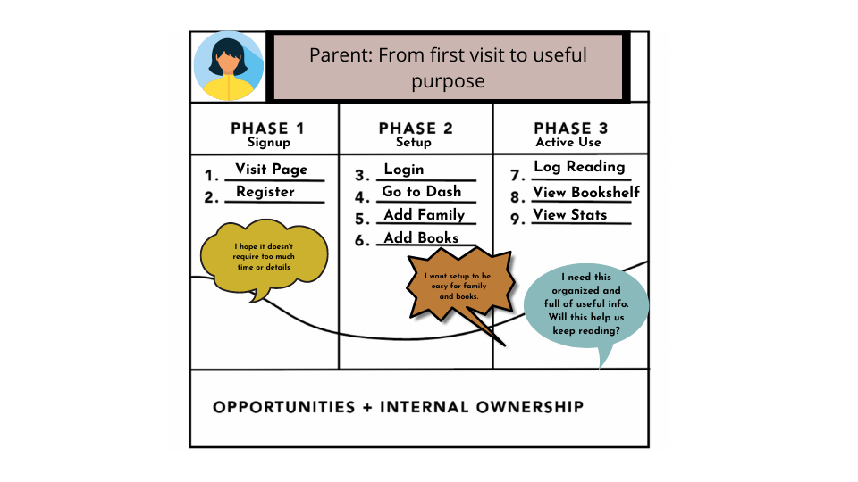
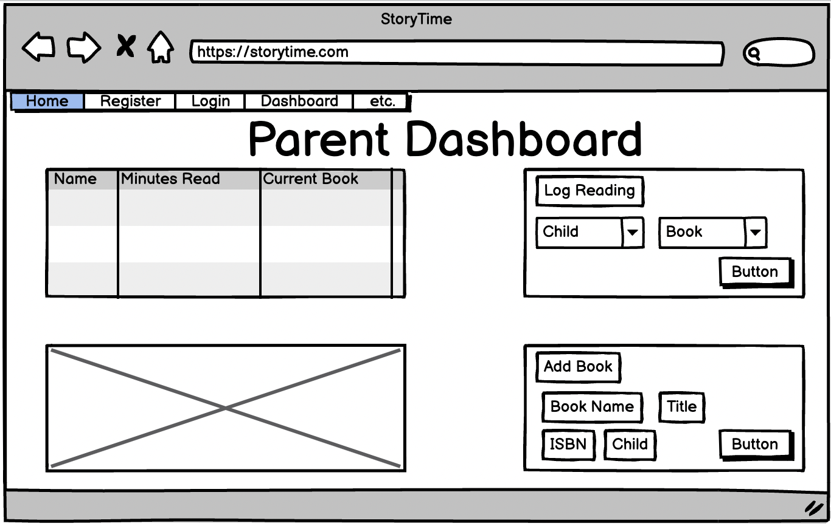
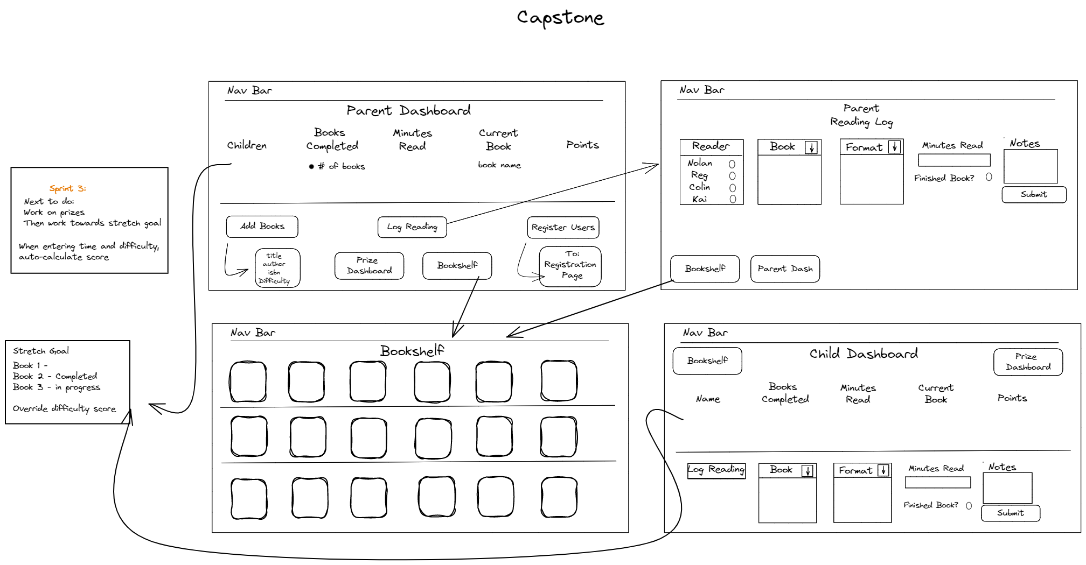

Slide 5
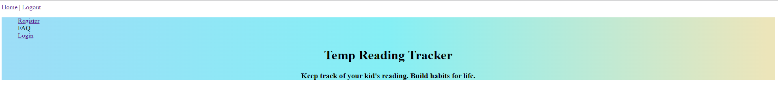
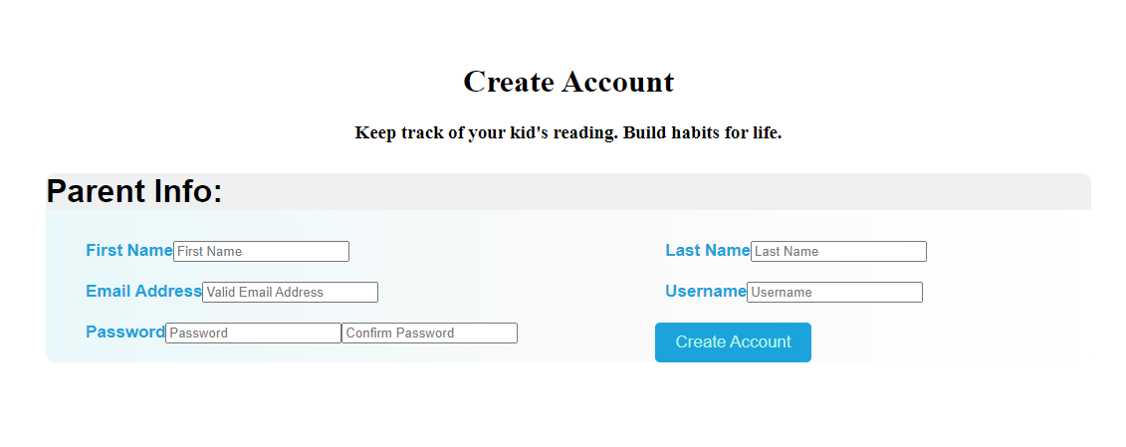
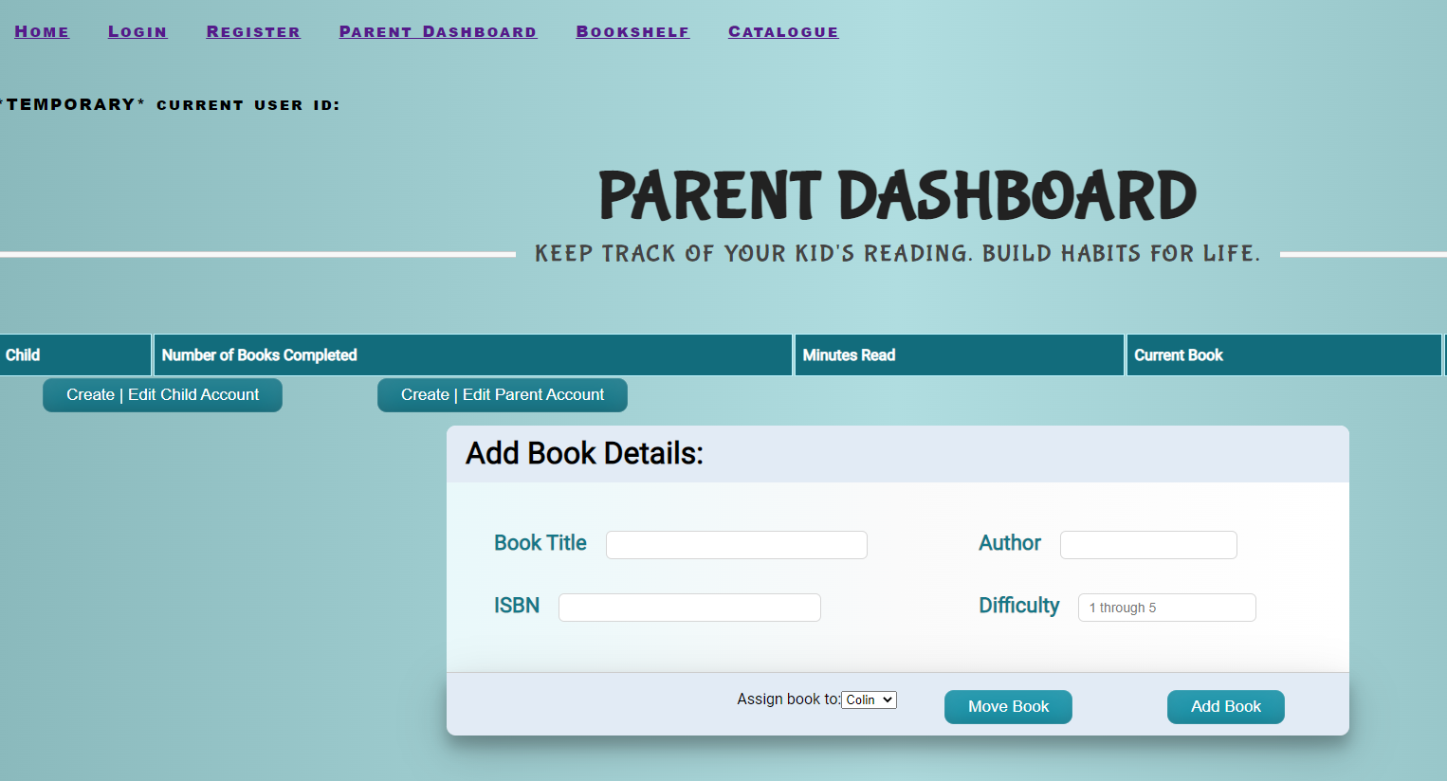
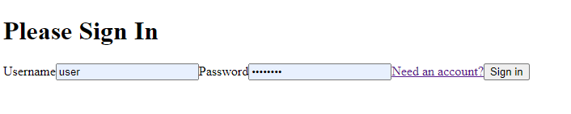
Humble Beginnings

